Slide 1


Interband cascade structures for infrared photodetectors and thermophotovoltaic devices
Hossein Lotfi
Ph.D. oral presentation
December 08, 2016

Slide 2
Outline
Background and motivations
Interband cascade devices: principles of operation
HOT long- and very long-wavelength ICIPs
High-performance short-wavelength ICIPs
High-frequency interband cascade systems
Monolithically integrated mid-IR laser and detector
Interband cascade thermophotovoltaic devices
Summary and research perspective

Slide 3
Outline
Background and motivations
Interband cascade devices: principles of operation
HOT long- and very long-wavelength ICIPs
High-performance short wavelength ICIPs
High-frequency interband cascade systems
Monolithically integrated mid-IR laser and detector
Interband cascade thermophotovoltaic devices
Summary and research perspective

Slide 4
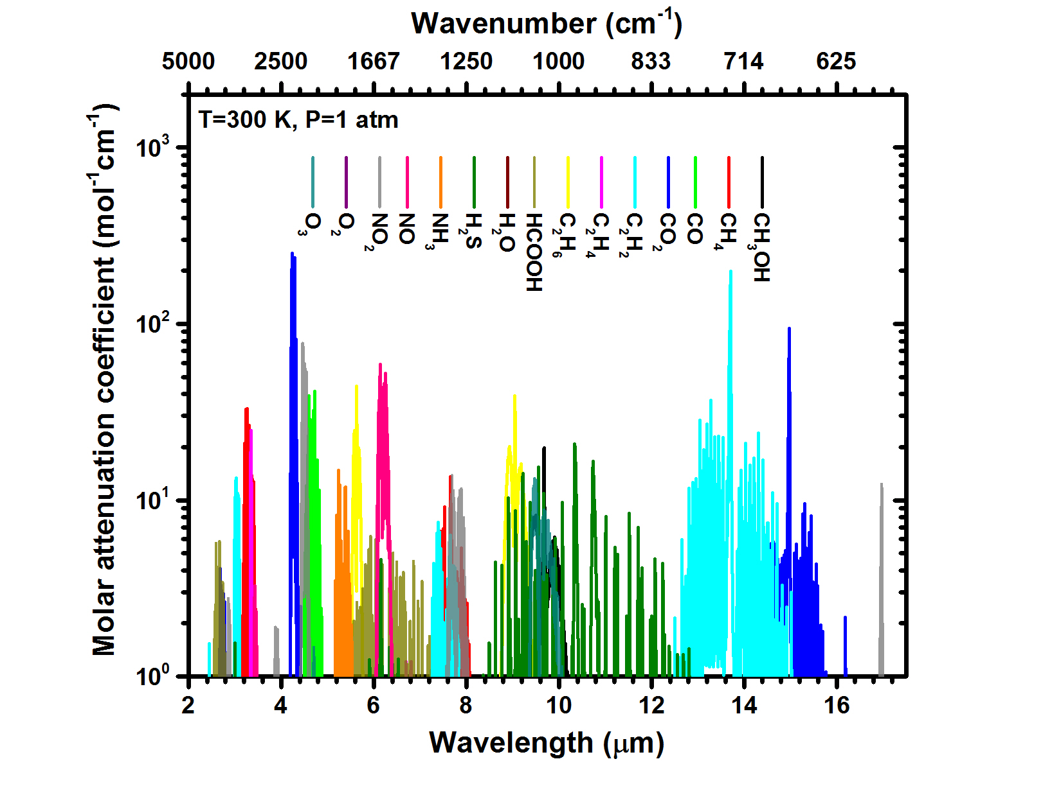

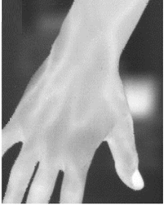
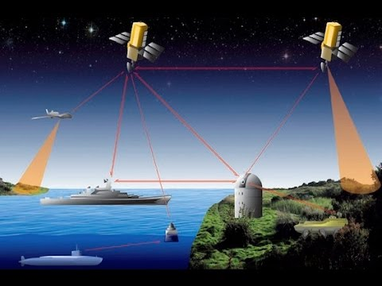
Background and motivations
Image source: JPL
Data from: HITRAN
Molecule and gas sensing
Thermophotovoltaic devices
Thermal imaging
Free space communication
Tian et al, Appl. Phys. Lett. 2014

Slide 5
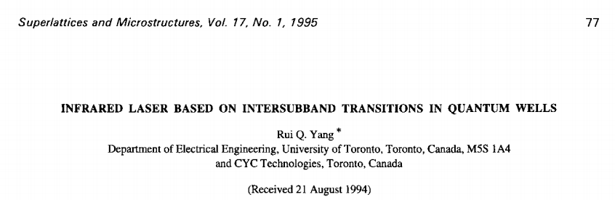
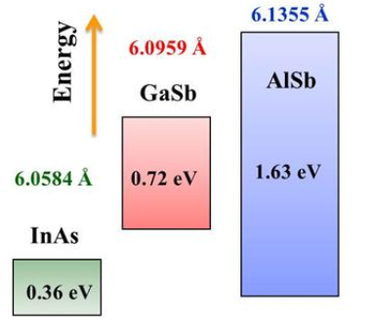
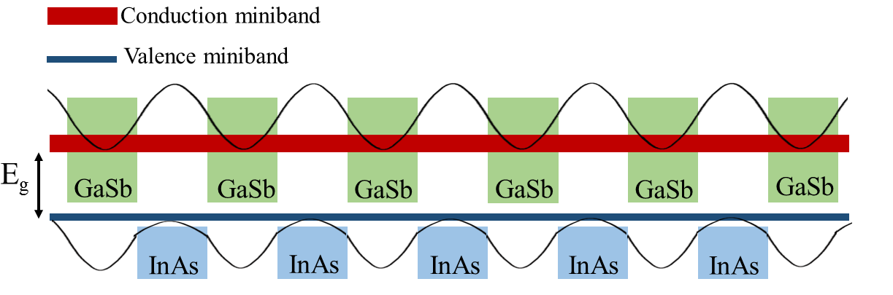
Interband cascade (IC) devices: background
Family of IC devices:
Interband cascade lasers
Interband cascade IR photodetectors
Interband cascade photovoltaic devices
6.1 Å material family

Slide 6
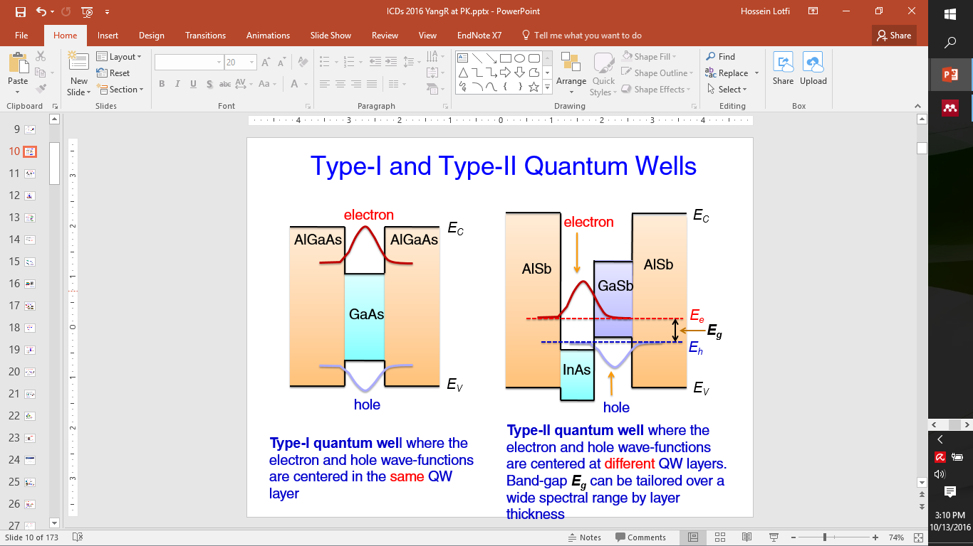
Type-I vs. type-II quantum wells
The electron and hole wave functions are spatially located in the same layer
The electron and hole wave functions are spatially located in different layers

Slide 7
Outline
Background and Motivations
Interband cascade devices: principles of operation
HOT long- and very long-wavelength ICIPs
High-performance short wavelength ICIPs
High-frequency interband cascade systems
Monolithically integrated mid-IR laser and detector
Interband cascade thermophotovoltaic devices
Summary and research perspective

Slide 8
Interband cascade lasers
multiple photons per electron
(Type-II QWs)
carrier injection
hv
(Type-II QWs)
interband
tunneling
hv
interband
active region
tunneling
hv
active region
carrier extraction
active region
Benefits of cascade lasers:
High efficiency
Large output power
Uniform carrier injection in every stage
Low carrier concentration

Slide 9
Interband cascade IR photodetectors
electron barrier
electron barrier
E
SL
absorber
QWs
with
type-II
hetero-interface
SL
absorber
QWs
with
type-II
hetero-interface
intraband
relaxation
intraband
relaxation
GaSb/AlSb QWs
e
e
e
E_{e}
hν
hv
hv
E_{h}
digitally graded AlSb/InAs QWs
interband
tunneling
excitation
(2)
(1)
(3)
(2)
(1)
(3)
(2)
InAs/GaSb SL
hole barrier
hole barrier
hole barrier
one interband cascade stage – double heterostructure unit
ICL vs. ICIP
e
E
hv
multiple photons are required to output one electron
hv
hv
hv
hv
hv
hv
hv
hv
hv
hv

Slide 10
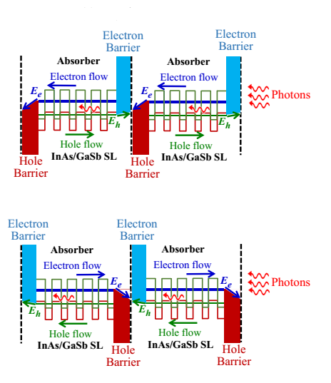
Different configurations for ICIPs
Regular configuration
Early ICIPs had regular configuration
Electron barrier is located at the top and
hole barrier is located at the bottom of each
stage
Electrons need to diffuse a longer distance
Hole barrier located at the top and
electron barrier is located at the bottom of
each stage
Electrons are populated closer to the
collection point
Reverse configuration

Slide 11
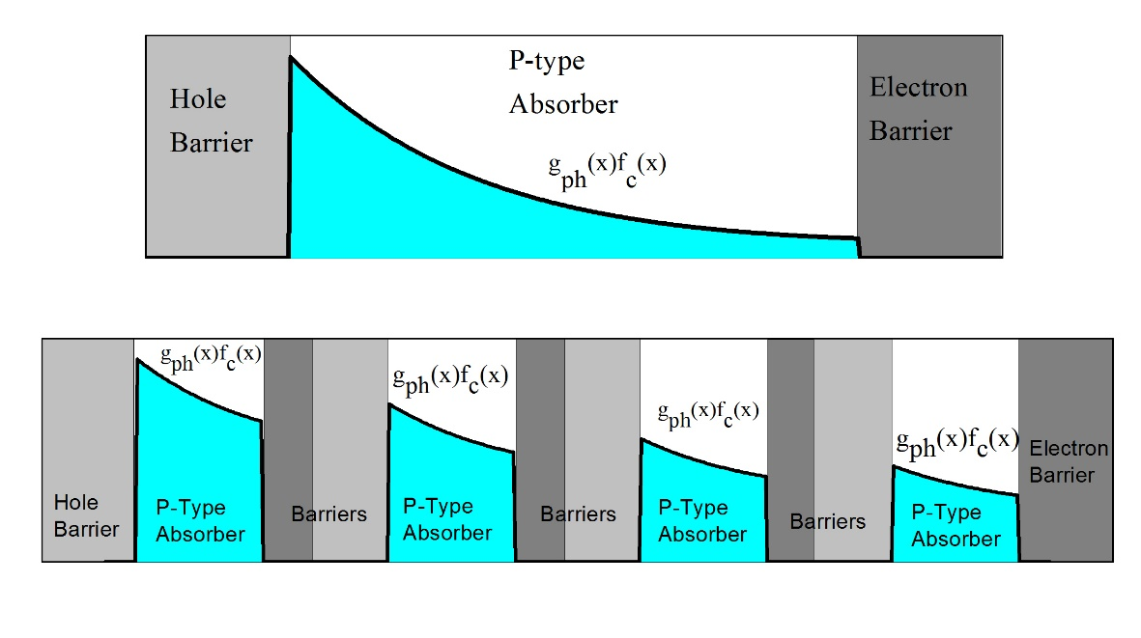
High-operating-temperature (HOT) IR detectors
Thick absorbers are required to ensure enough photon absorption (large QE)
Problems:
Decreased diffusion length at high temperatures
Very small device resistance
Large dark currents and large noise
Long carrier transit time
Solution:
R. T. Hinkey and R. Q. Yang, Proc. SPIE 8868, (2013)

Slide 12
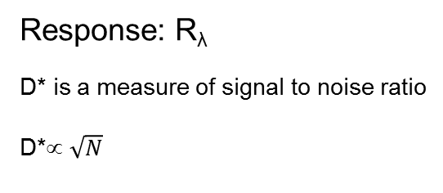
Multiple stages vs. single stage
ICIP
single-absorber detector
R₁
R₂
R_{N}
Absorber thickness: L_{sing}=N·L
Absorber resistance → NR
Absorber resistance → R/N
Response: R_{λ}
D* is a measure of signal to noise ratio
D*∝ $\sqrt{N}$
Response: NR_{λ}
Where are the benefits of ICIPs?

Slide 13
Single vs. multiple stages: detectivity
R. T. Hinkey and R. Q. Yang, Journal of Applied Physics, (2013)

Slide 14
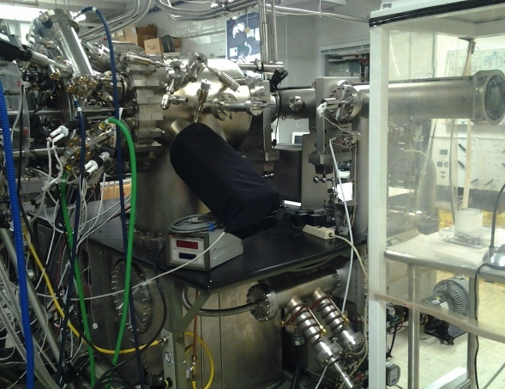
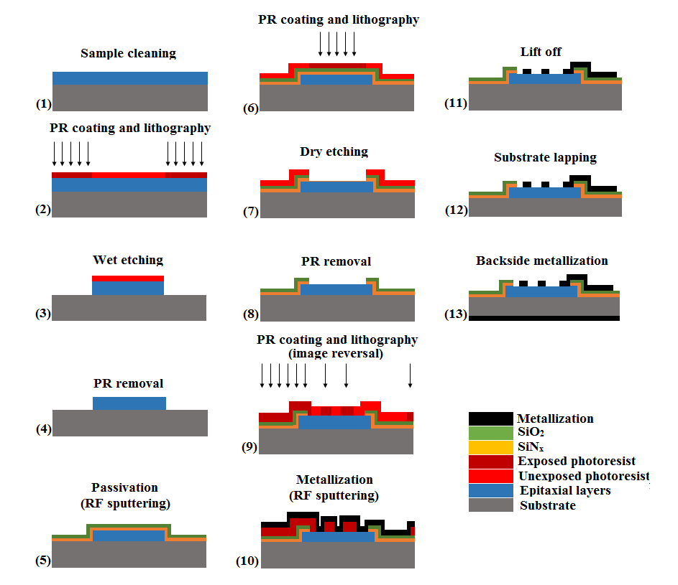
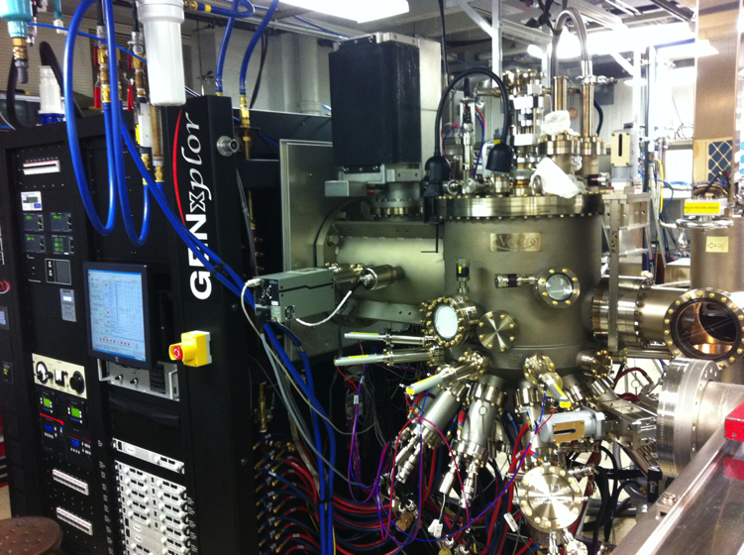
MBE growth and device fabrication

Slide 15
Outline
Background and Motivations
Interband cascade devices: principles of operation
HOT long- and very long-wavelength ICIPs
High-performance short wavelength ICIPs
High-frequency interband cascade systems
Monolithically integrated mid-IR laser and detector
Interband cascade thermophotovoltaic devices
Summary and research perspective

Slide 16
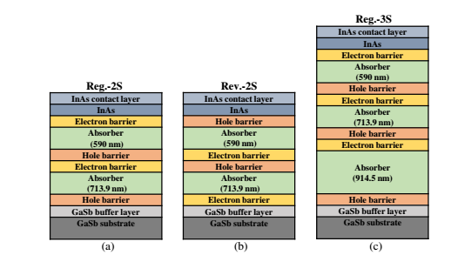
HOT long-wavelength ICIPs
Three ICIPs with identical unipolar barriers and absorber’s SL period
Goal: to investigate the effects of different number of stages and illumination direction on device performance

Slide 17
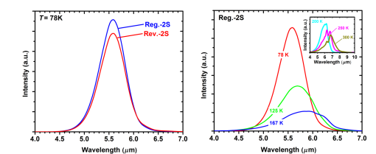
Long-wavelength ICIPs
XRD measurements: similar interface and material quality in the three wafers
EL measurements: two wafers had similar structural and interface quality, while wafer Reg.-2S may have somewhat better optical properties.

Slide 18
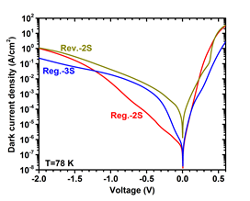
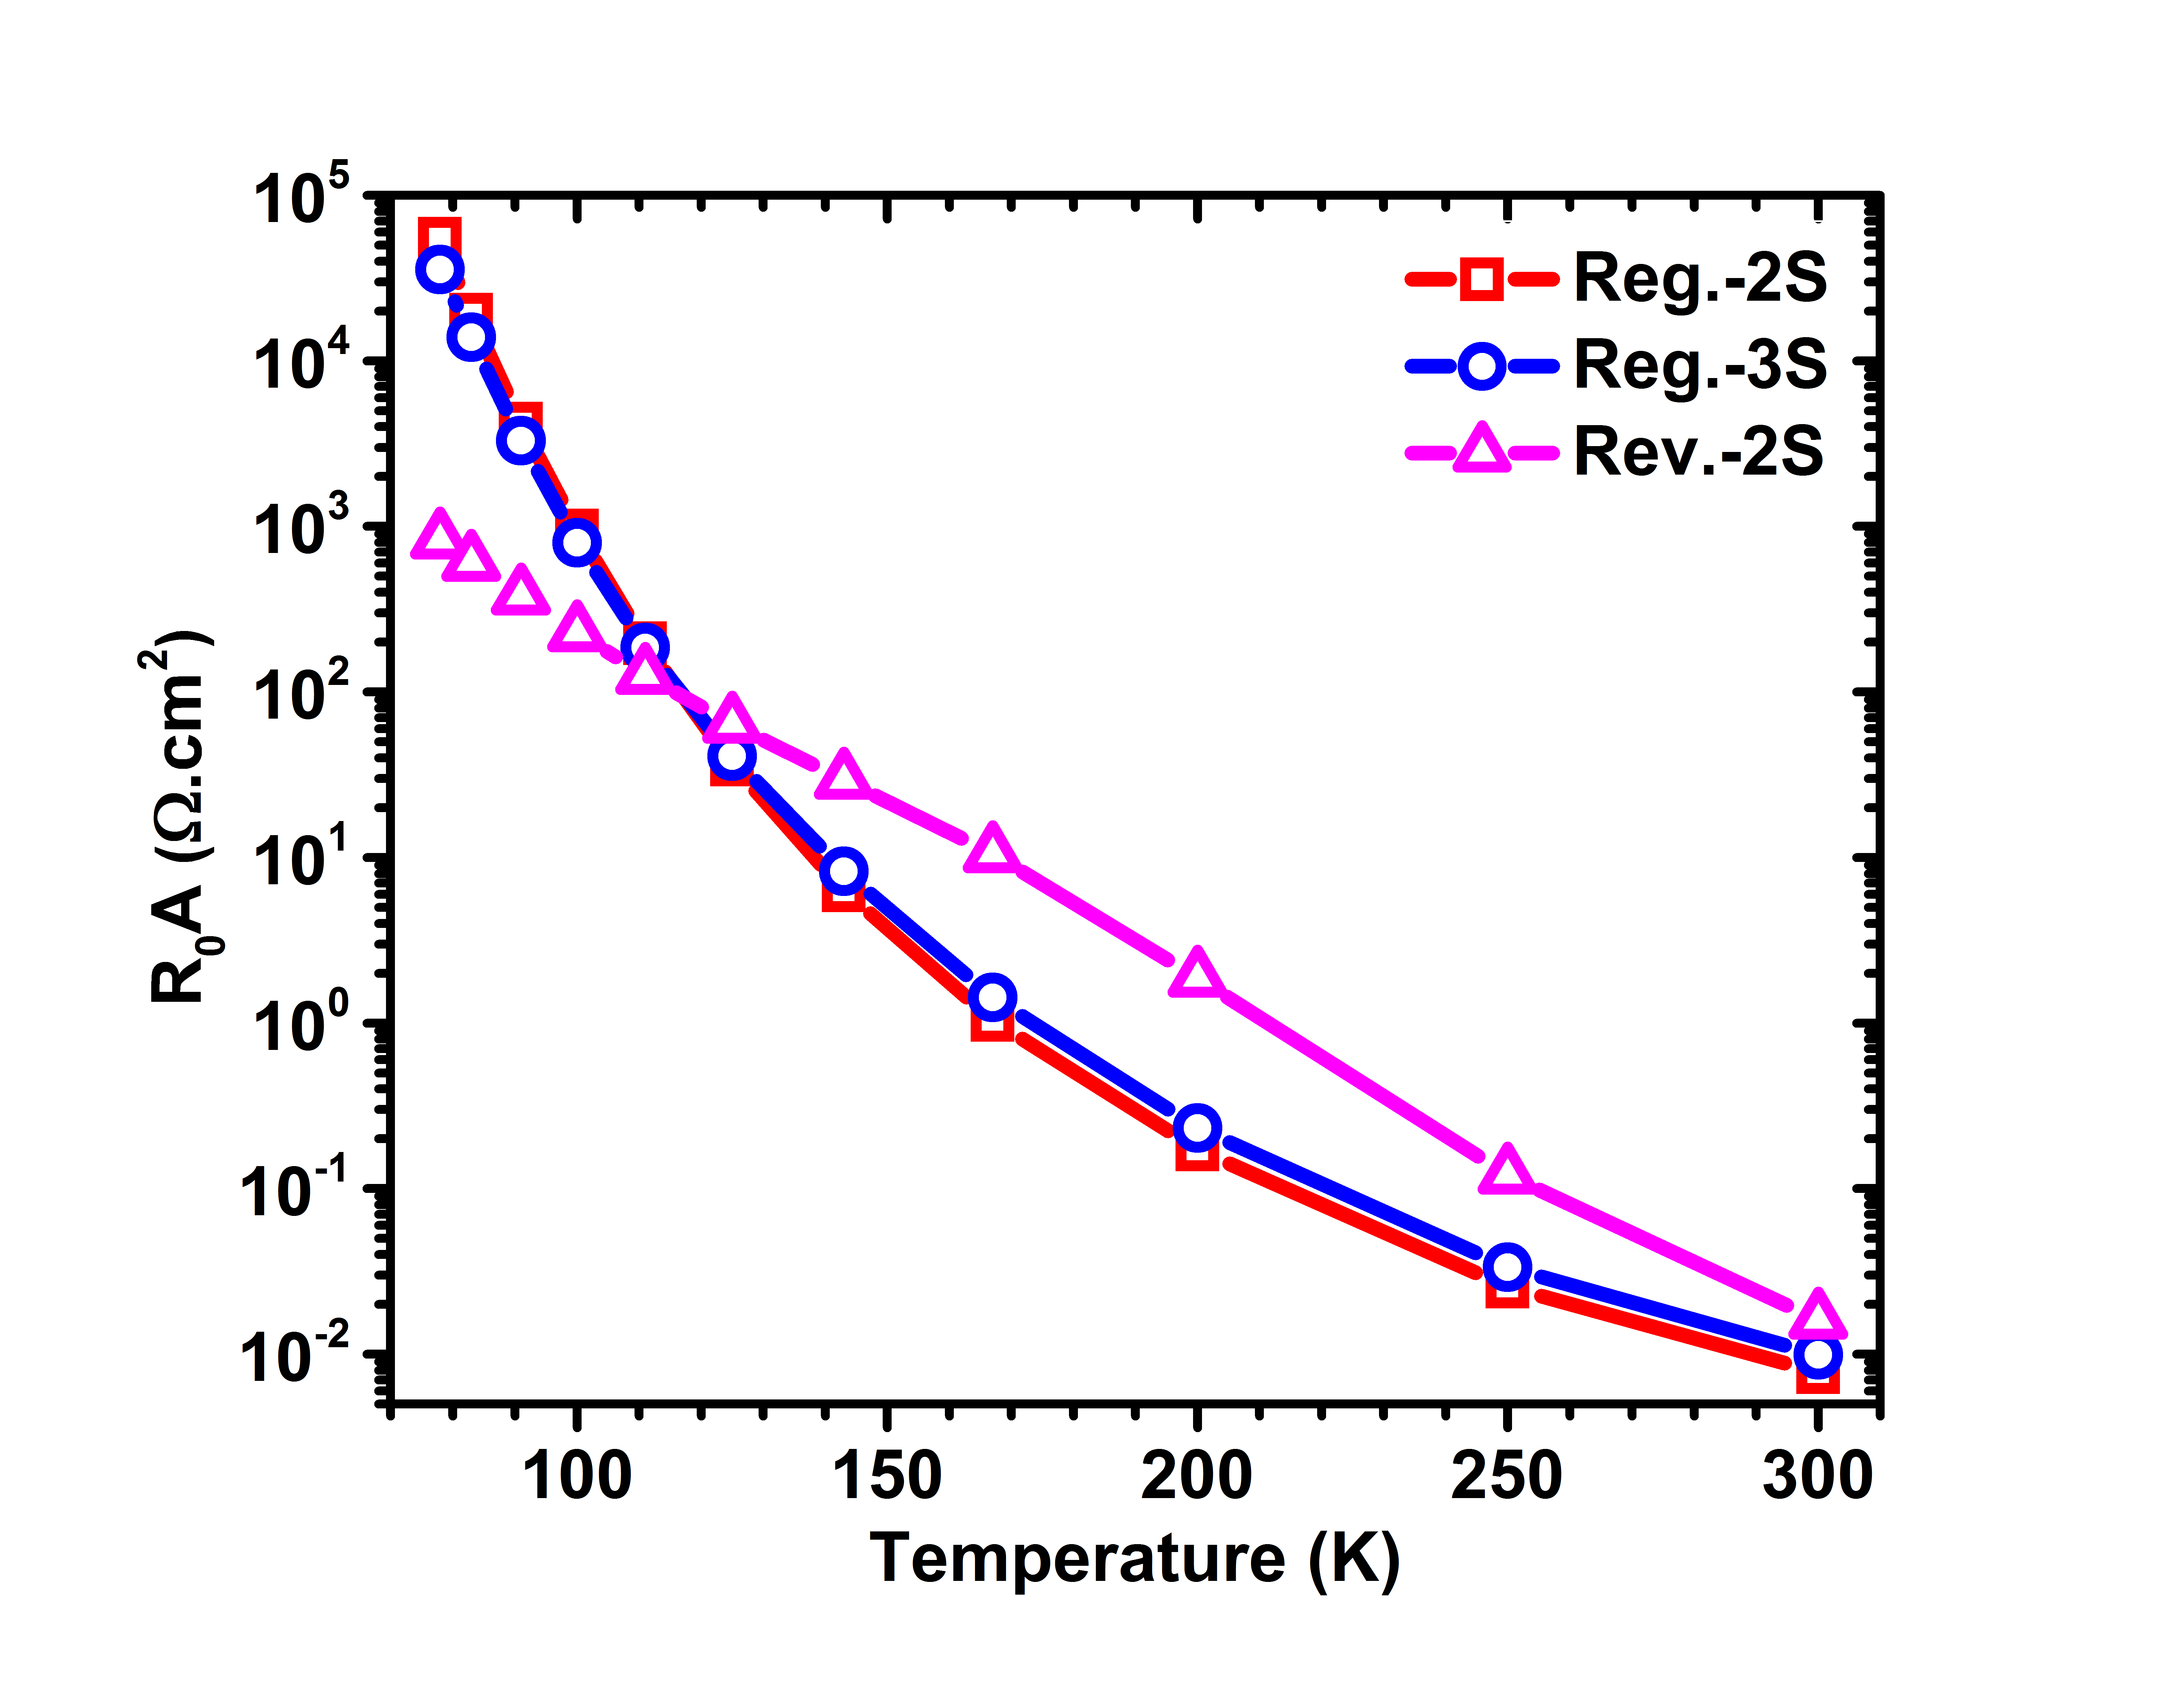
Long-wavelength ICIPs
The measured dark currents did not follow the theory of ideal ICIPs at low temperatures
The material growth and/or device fabrication variations from one wafer to another

Slide 19
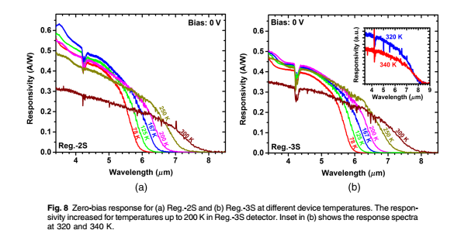
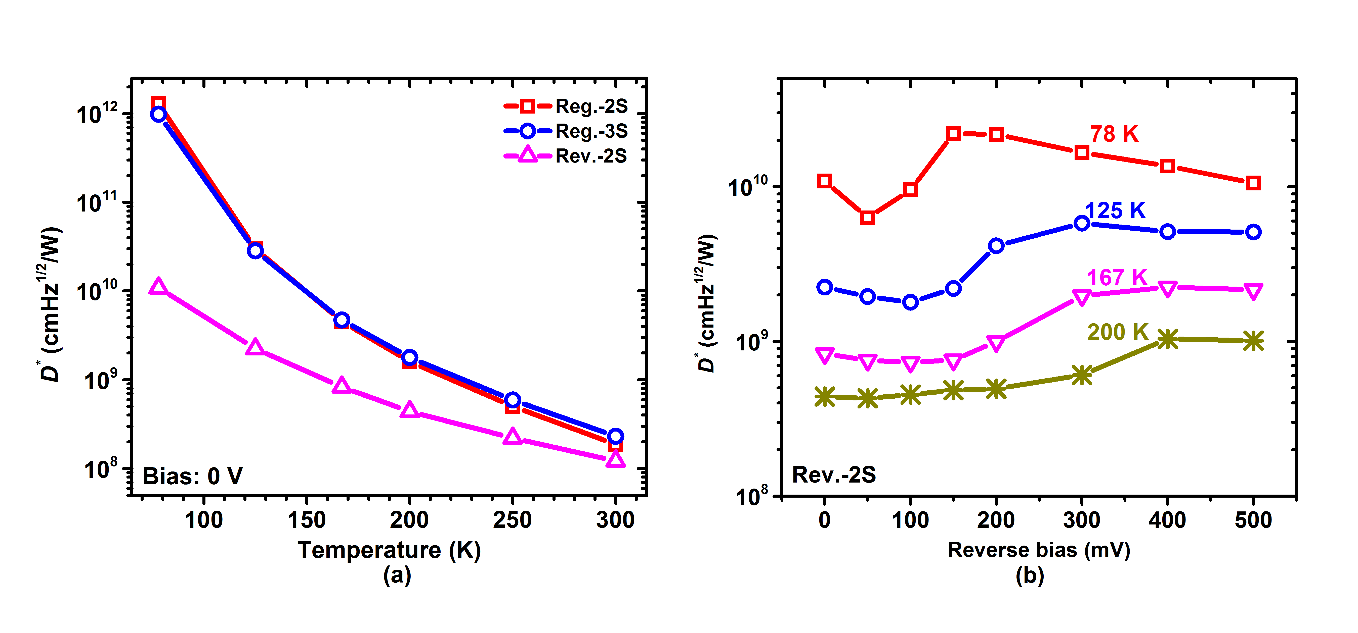
Long-wavelength ICIPs
λ=5 μm
Lower responsivity in the three-stage ICIPs (10% at λ=5 μm)
Larger detectivity in the three-stage ICIPs at 125 K and above
Rev.-2s had poor electrical and optical performance low D*

Slide 20
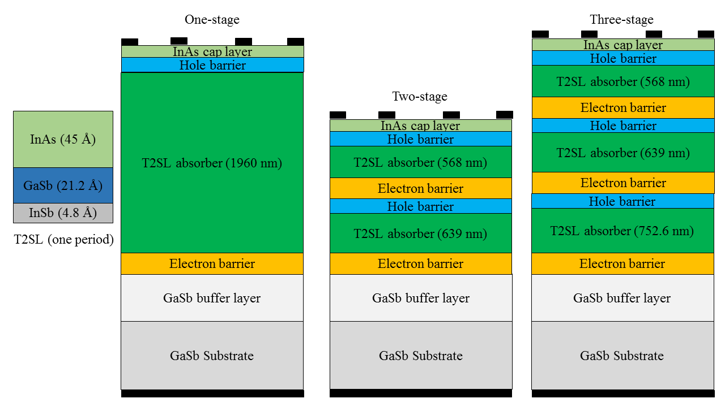
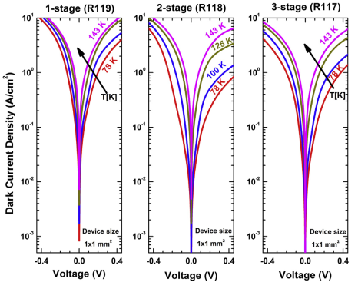
Very long-wavelength (λ_{c}=16 μm) ICIPs
Three photo-current ICIP with
reverse configuration
Dark current density at 78 K and 50 mV:
One-stage device: 100 mA/cm²
Three-stage ICIP: 25 mA/cm²
Two-stage ICIP: 24 mA/cm²

Slide 21
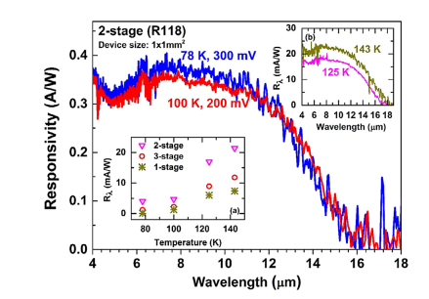
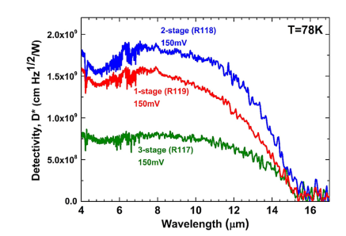
Very long-wavelength ICIPs
The zero-bias responsivity was low in the VLWIR wafers
The zero-bias responsivity increased with temperature
These observations support the existence of an unwanted electrostatic barrier

Slide 22
Outline
Background and Motivations
Interband cascade devices: principles of operation
HOT long- and very long-wavelength ICIPs
High-performance short wavelength ICIPs
High-frequency interband cascade systems
Monolithically integrated mid-IR laser and detector
Interband cascade thermophotovoltaic devices
Summary and research perspective

Slide 23
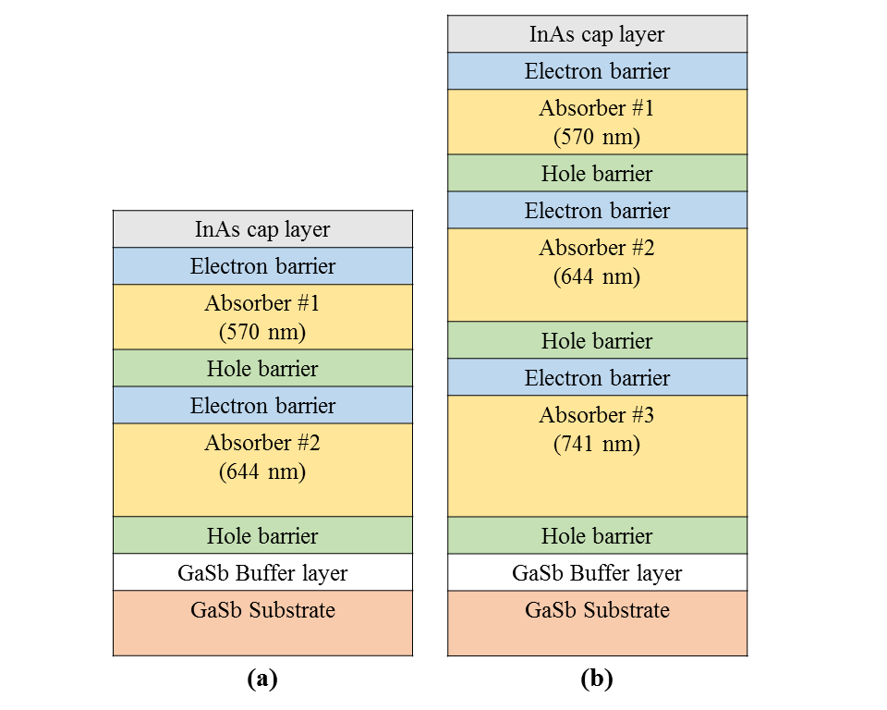
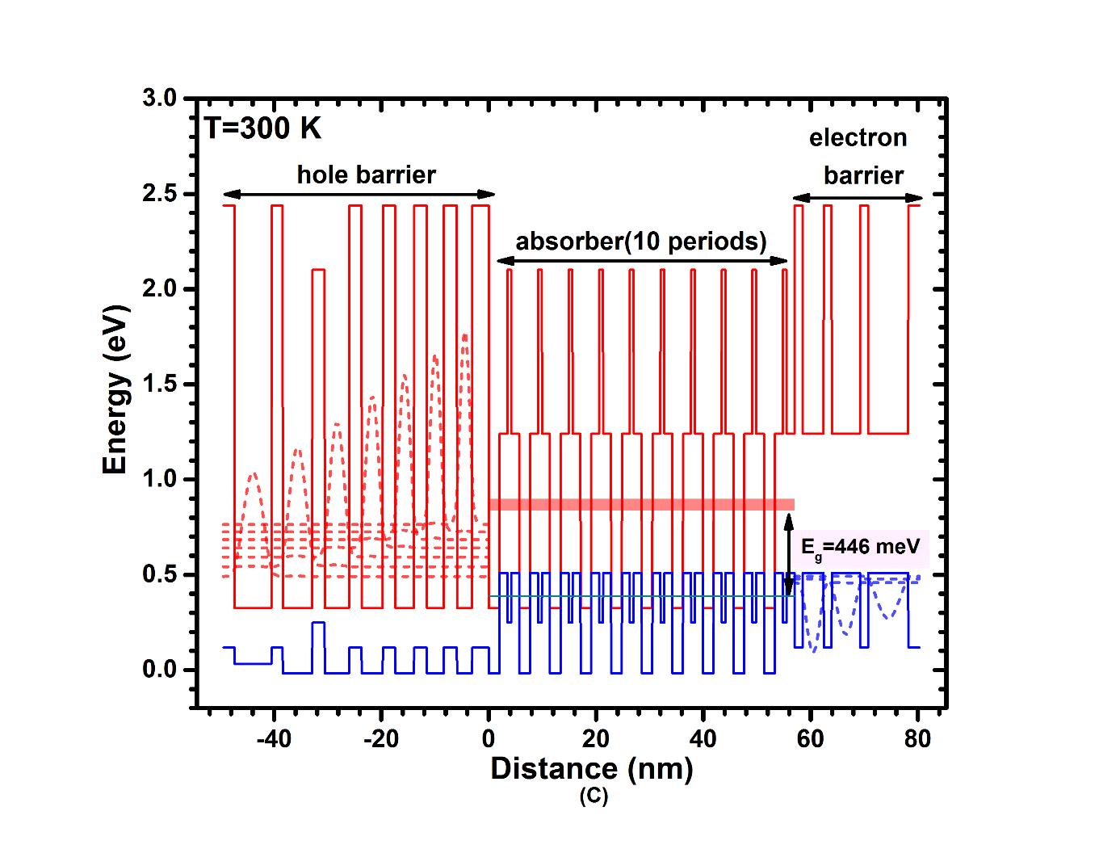
Short-wavelength ICIPs
Three-stage
Cutoff wavelength: 2.8 μm
Two-stage

Slide 24
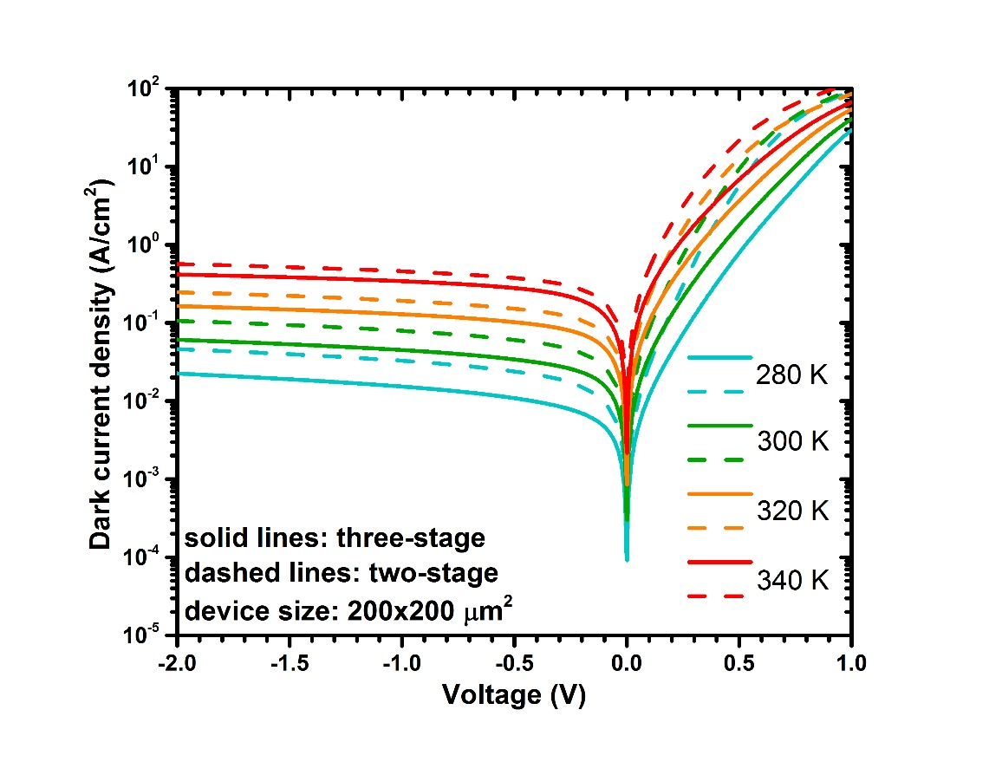
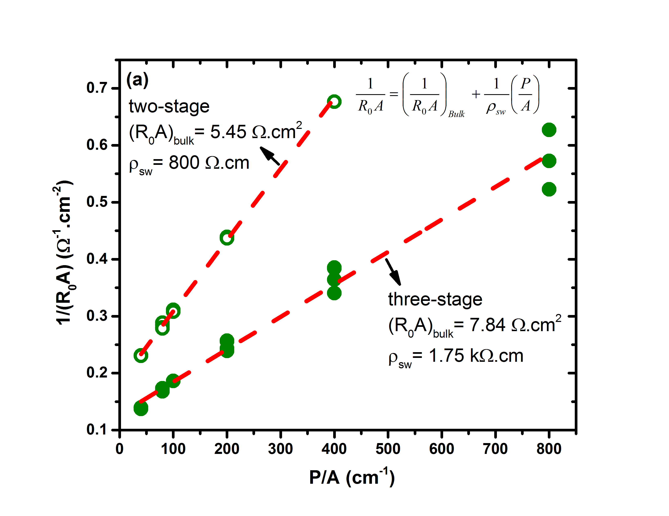
Device performance: dark current
Dark current was lower in three-stage ICIPs compared to two-stage ICIPs
Size dependent dark current densities were observed in both wafers
Lotfi, et al., Journal of Applied Physics (2016)

Slide 25
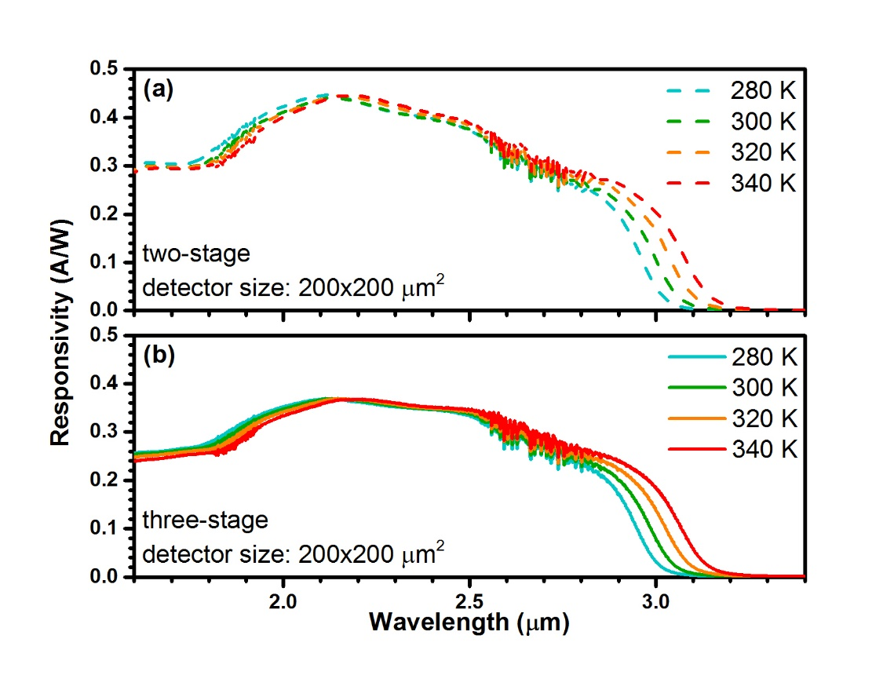
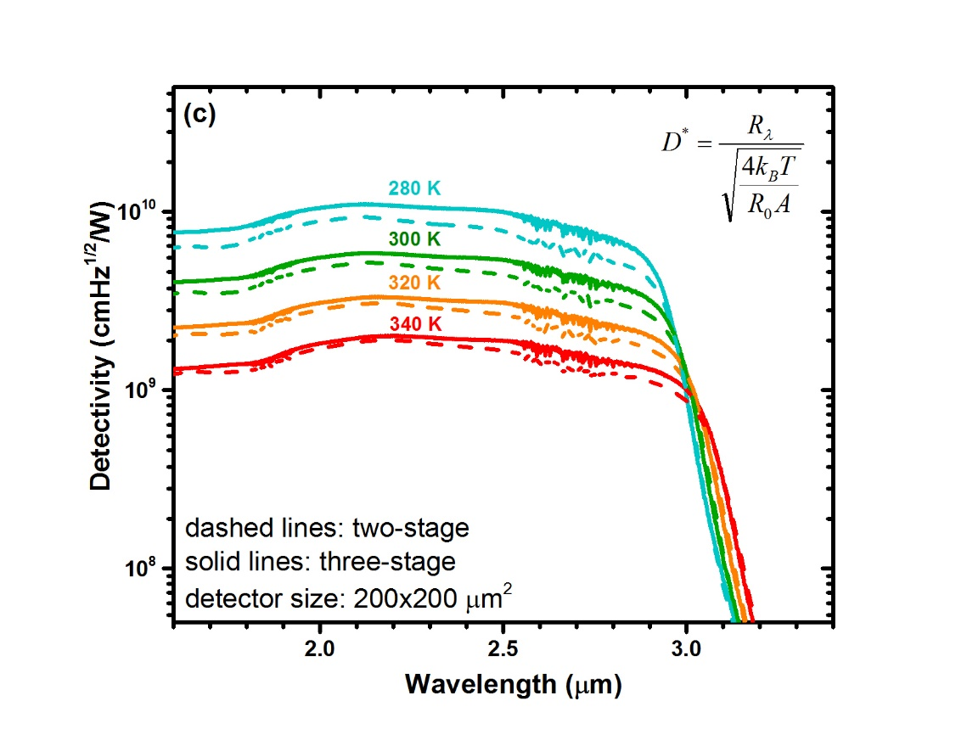
Device performance: optical
Lower responsivity in the three-stage ICIPs (16%)
Larger detectivity in the three-stage ICIPs
There is room for improvements

Slide 26
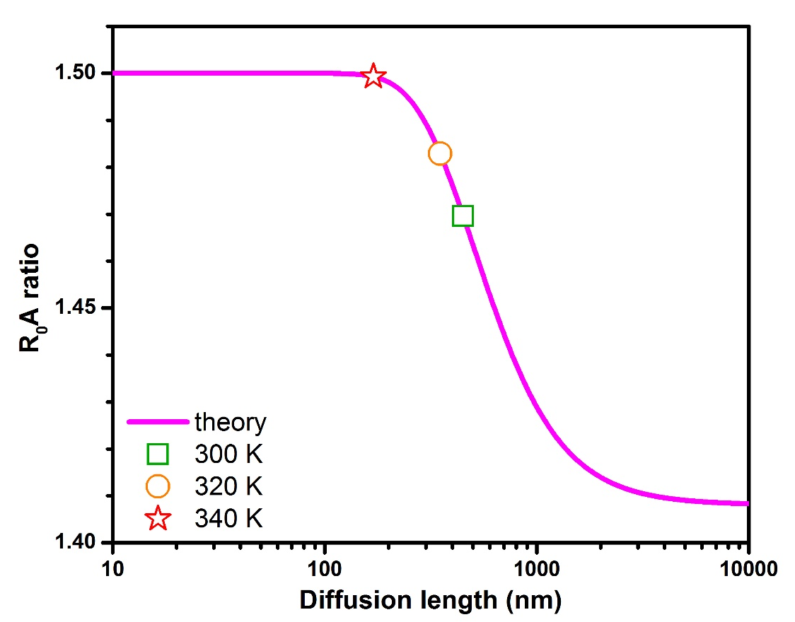
Diffusion length estimation
Larger set of detectors decreases the uncertainty
Specific designs will have larger margins
≤170 nm
340 K
350 nm
320 K
300 K
450 nm
Bulk R₀A, no surface currents
Diffusion limited transport
Uniform material and fabrication
Exp.

Slide 27
Outline
Background and Motivations
Interband cascade devices: principles of operation
HOT long- and very long-wavelength ICIPs
High-performance short wavelength ICIPs
High-frequency interband cascade systems
Monolithically integrated mid-IR laser and detector
Interband cascade thermophotovoltaic devices
Summary and research perspective

Slide 28
Single vs. multiple stages: speed
Shorter absorbers reduce the transit time → high-speed operation
Higher speed with the same detectivity
ICIP
single-absorber detector
R₁
R₂
R_{N}
Absorber thickness: L_{sing}=N·L
Absorber resistance → NR
Absorber resistance → R/N
Response: R_{λ}
Response: NR_{λ}

Slide 29
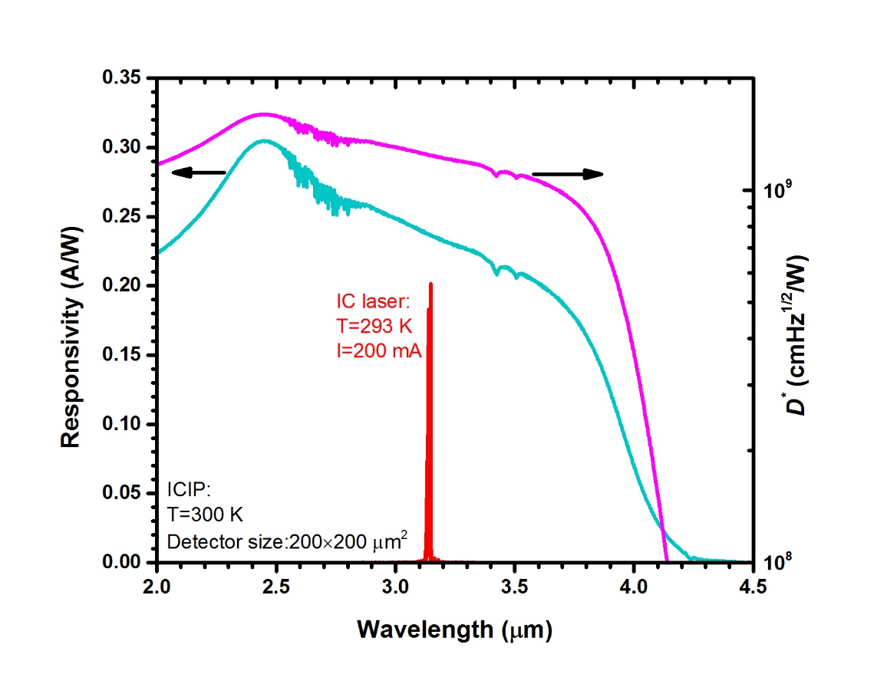
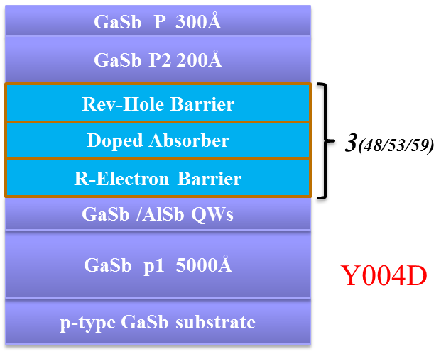
Device structure and characteristics
Devices with different number of stages and absorbers were grown
Three-stage ICIP with reverse configuration:

Slide 30
High-frequency modulation setup

Slide 31
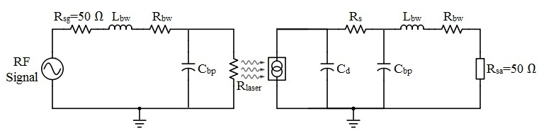
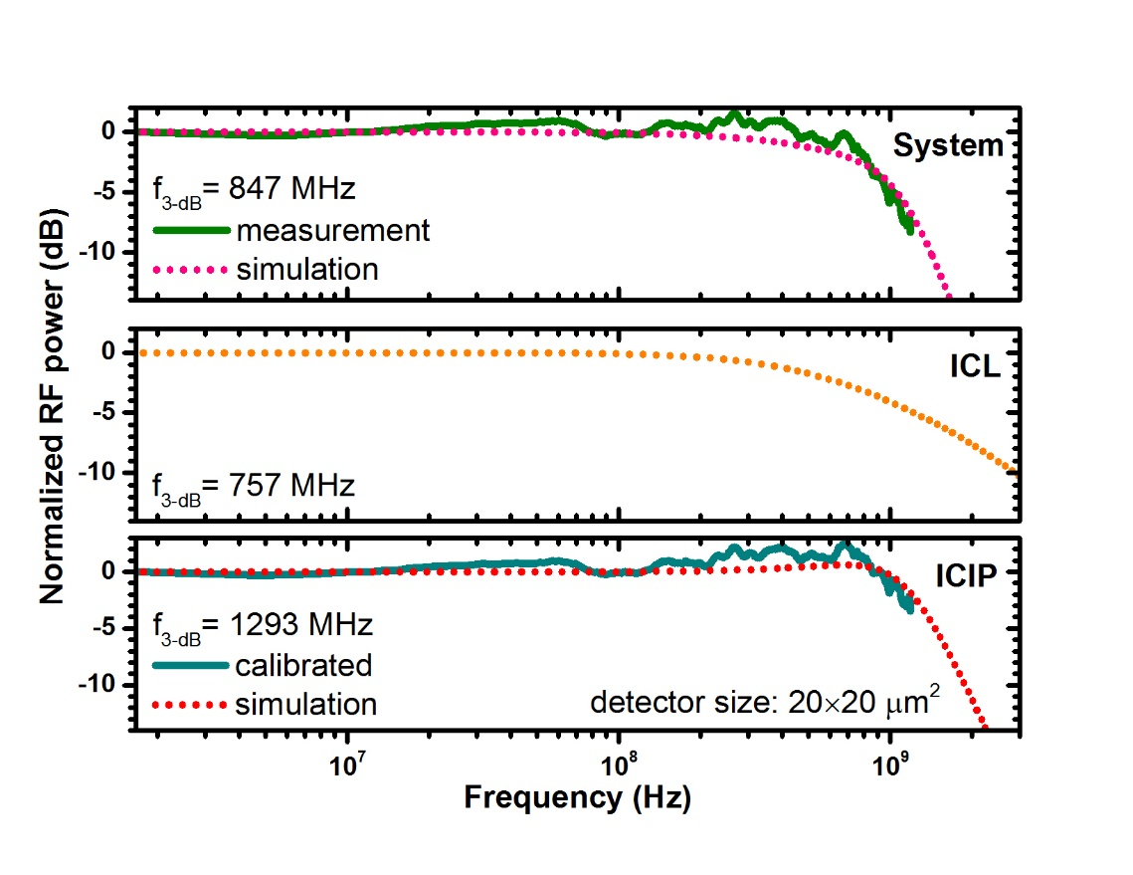
System performance: circuit model
System BW:
850 MHz
ICL BW:
760 MHz
ICIP BW:
1.3 GHz

Slide 32
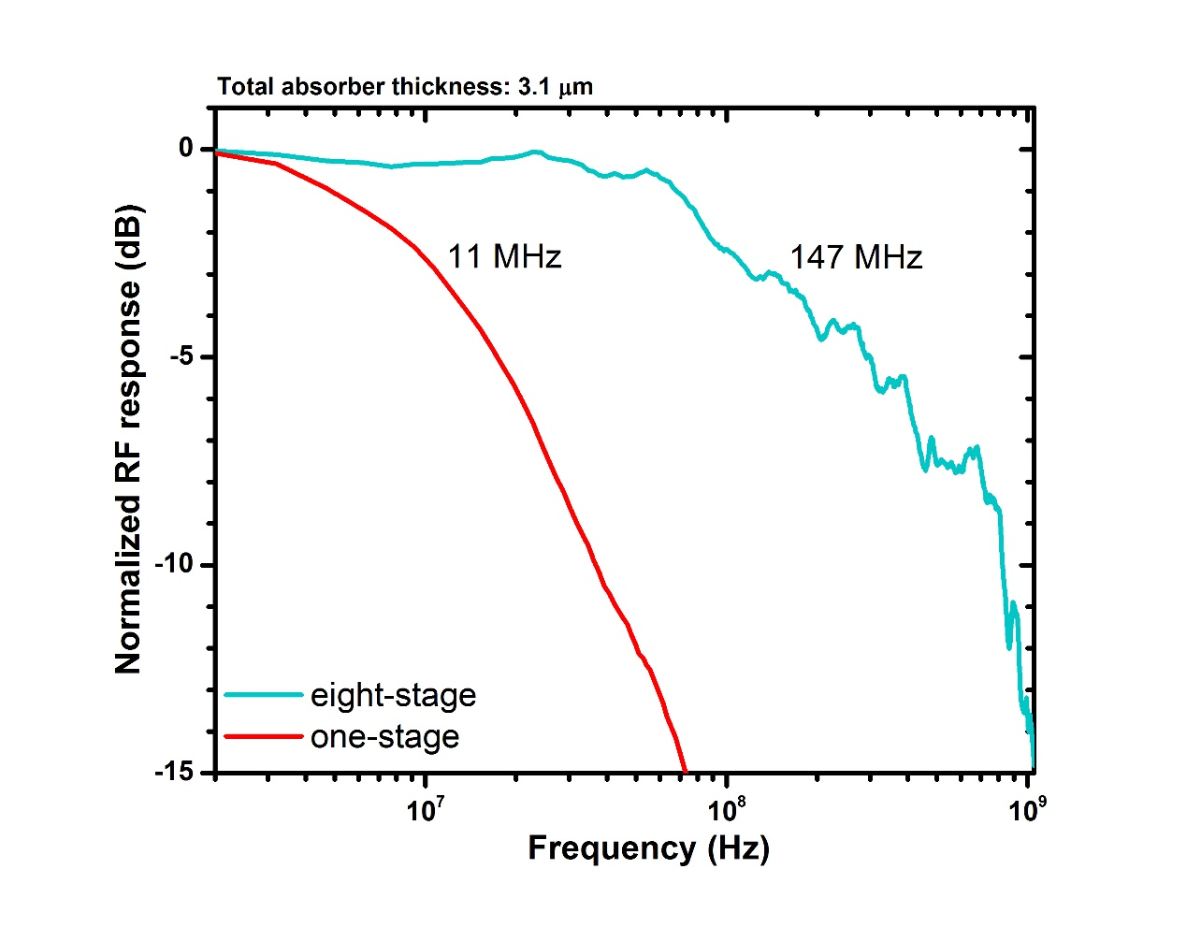
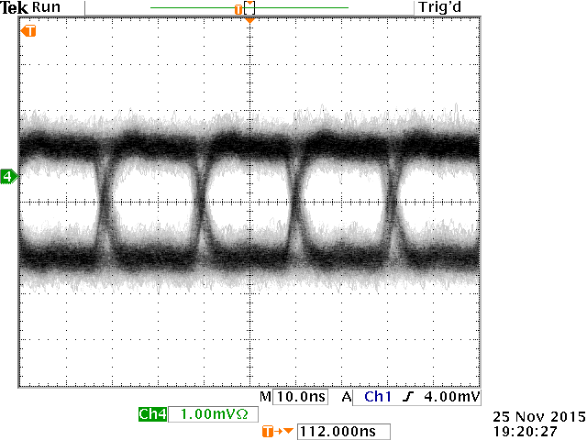
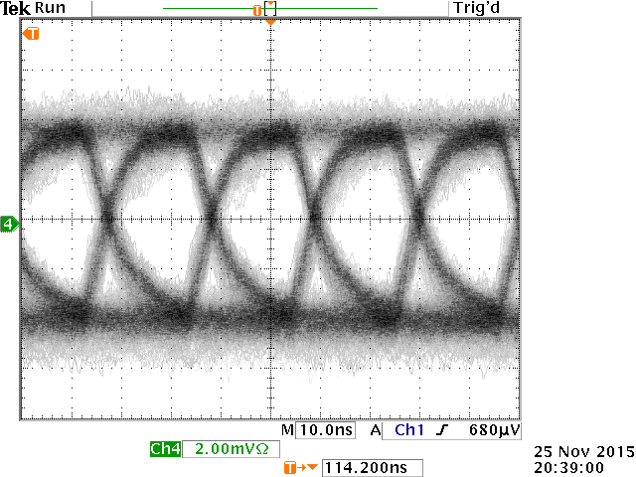
Single vs. multiple stage ICIP
Single- and multiple stage ICIPs had similar (3.1 μm) total absorber thickness
Both detectors had similar zero-bias normalized detectivities (~1×10⁹ cmHz^{1/2}/W)
Bit rate of 48 Mb/s
eight stage
one stage, absorber: 1 μm

Slide 33
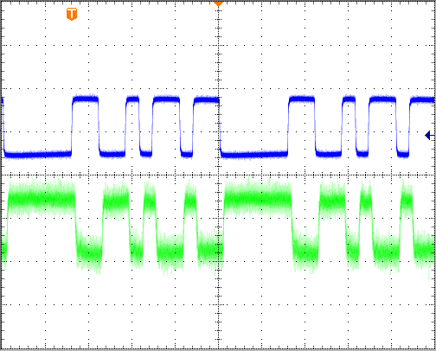
Input and Output Bit Sequence
Input bits to an IC laser
0 0 0 0 0 11 00 1 0 11 0 11
Inverted output bits from an ICIP
R146 (50×50 μm²)
100 ns per division

Slide 34
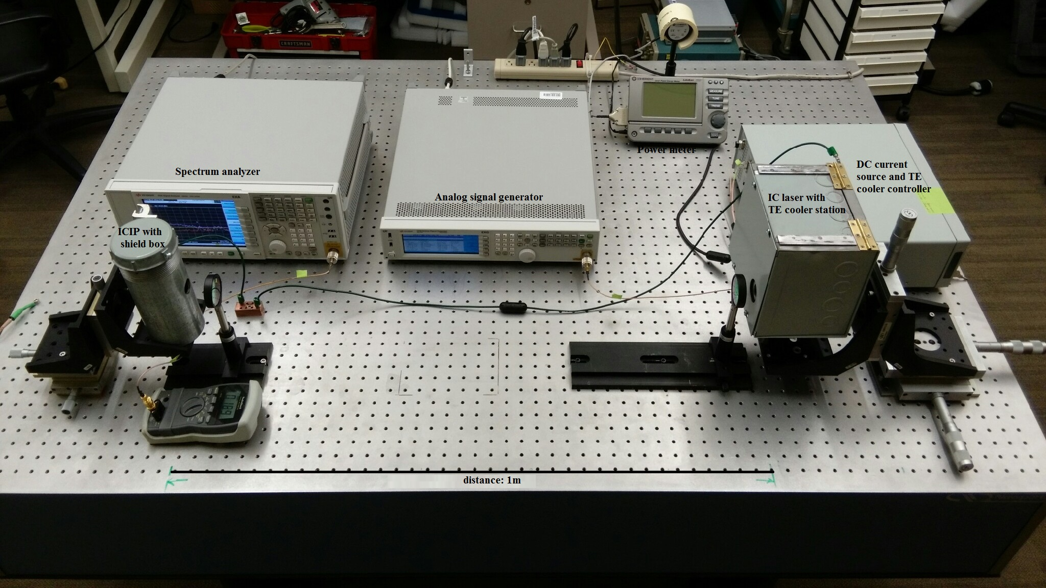
Free space optical communication link

Slide 35
Outline
Background and Motivations
Interband cascade devices: principles of operation
HOT long- and very long-wavelength ICIPs
High-performance short wavelength ICIPs
High-frequency interband cascade systems
Monolithically integrated mid-IR laser and detector
Interband cascade thermophotovoltaic devices
Summary and research perspective

Slide 36
Monolithically integrated mid-IR laser and detector
Base structure: type-I ICL with six-stages and GaInAsSb active regions
Focused ion beam (FIB) milling was employed to define each ICLD unit

Slide 37
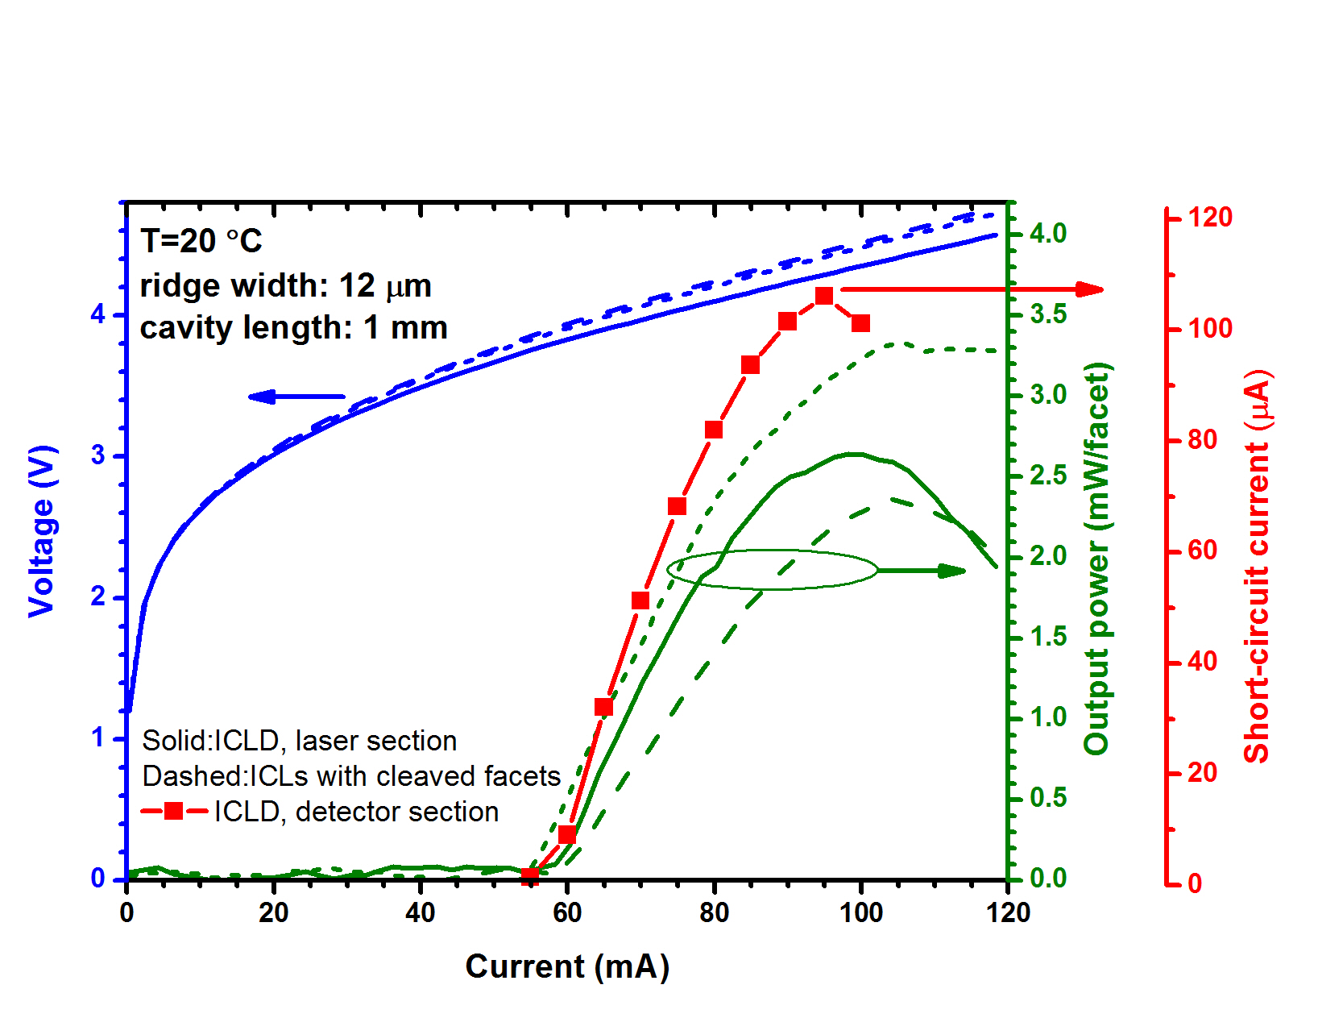
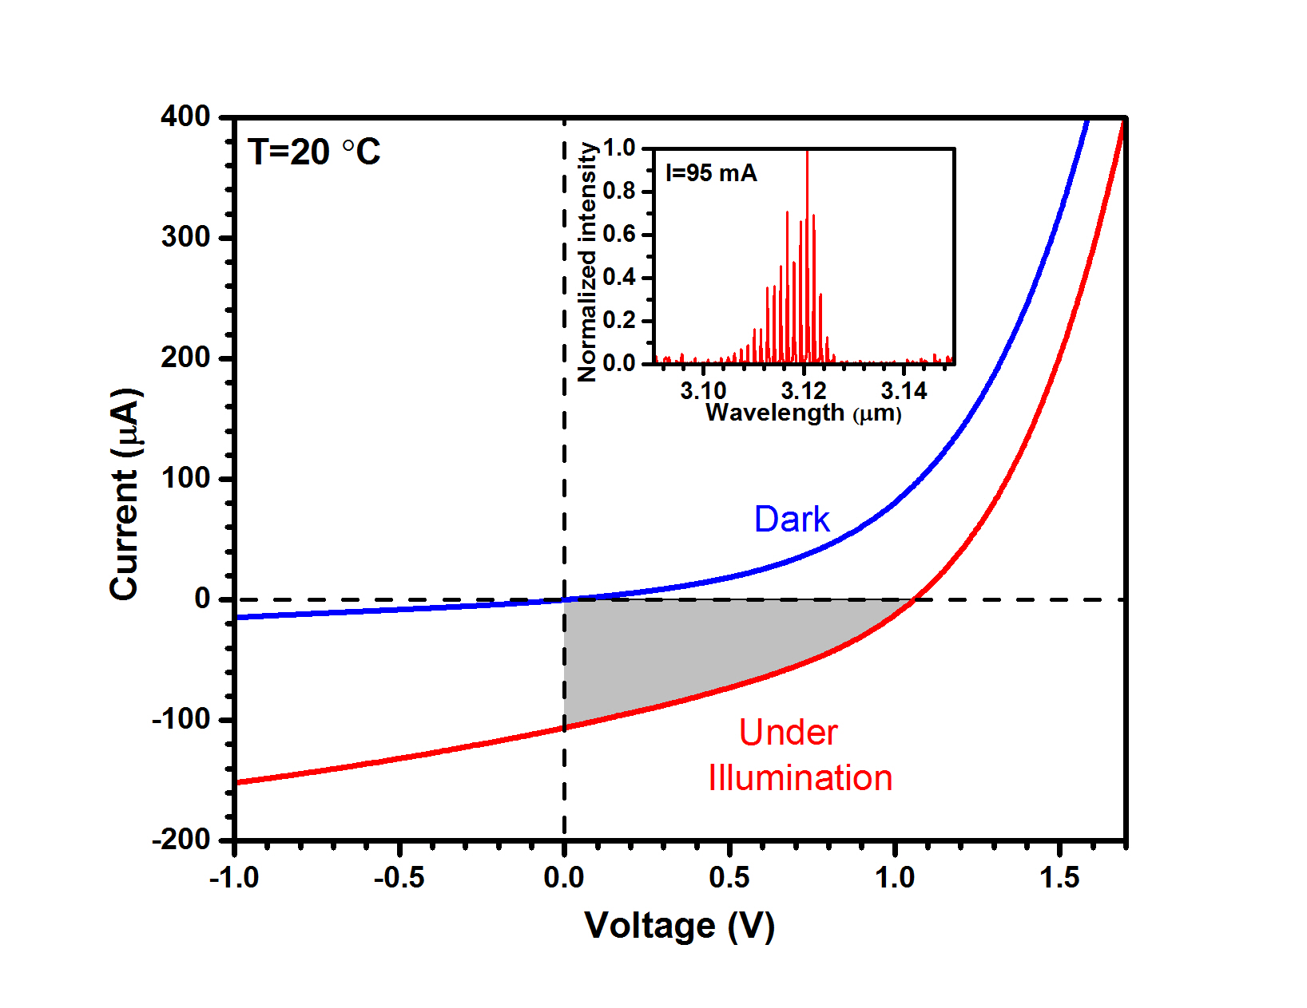
Monolithically integrated mid-IR laser and detector
Short-circuit current (I_{sc}) ~106 μA
Open-circuit voltage (V_{oc}) ~ 1.06 V >> E_{g}/e=0.38 V (cascade action)
Projected D*: ~1.85×10¹⁰ cm.Hz^{1/2}/W at 20 ◦C
Opens new horizons for high-performance miniaturized mid-IR systems

Slide 38
Outline
Background and Motivations
Interband cascade devices: principles of operation
HOT long- and very long-wavelength ICIPs
High-performance short wavelength ICIPs
High-frequency interband cascade systems
Monolithically integrated mid-IR laser and detector
Interband cascade thermophotovoltaic devices
Summary and research perspective

Slide 39
Interband cascade thermophotovoltaic devices
Harvest energy from thermal sources: solar, nuclear, waste heat
Heat sources from 1000 K to 2000 K
Optimum bandgap: 0.2 - 0.4 eV

Slide 40
Interband cascade thermophotovoltaic devices
Electron
Barrier
Electron
Barrier
Photons
Absorber
Electron
Barrier
Absorber
Electron flow
Electron flow
E_{e}
Absorber
E_{e}
Electron flow
E_{h}
E_{e}
E_{h}
Hole flow
InAs/GaSb SL
Hole flow
E_{h}
Hole
Barrier
InAs/GaSb SL
Hole
Barrier
Hole flow
Hole
Barrier
InAs/GaSb SL
one cascade stage
Circumvent the diffusion length limitation ⇒ High collection efficiency

Slide 41
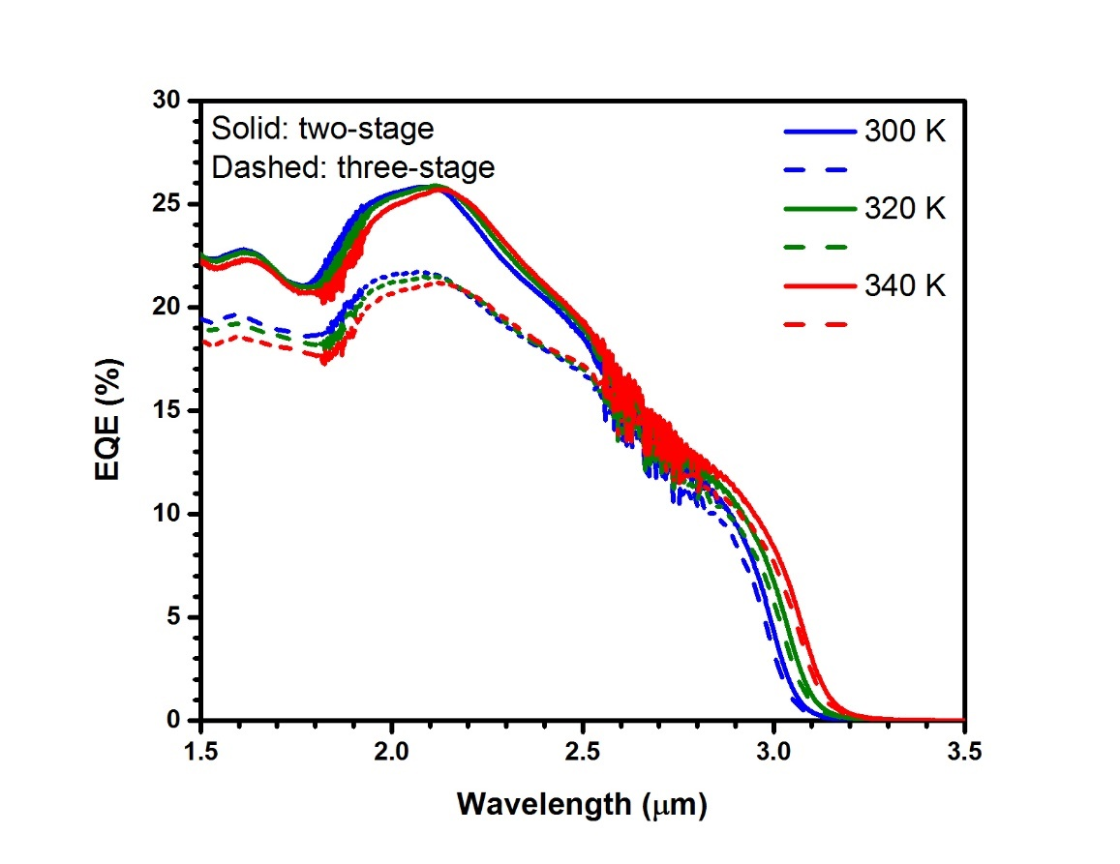
Interband cascade thermophotovoltaic devices
Three-stage
Two-stage
EQE was larger in twos-ate compared to three-stage devices

Slide 42
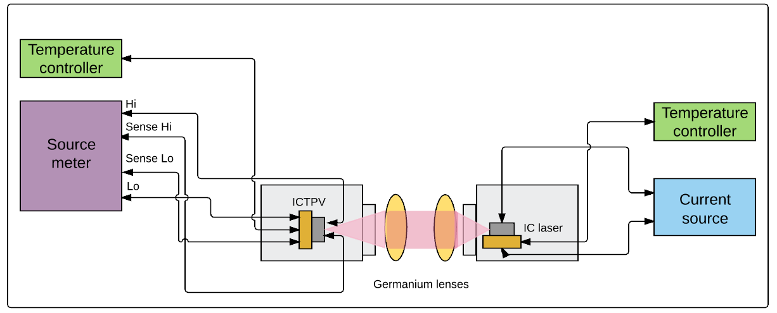
Interband cascade thermophotovoltaic devices
An IC laser used to mimic a selective emitter
Four wire setup: to reduce the parasitic resistances influence at high illumination levels

Slide 43
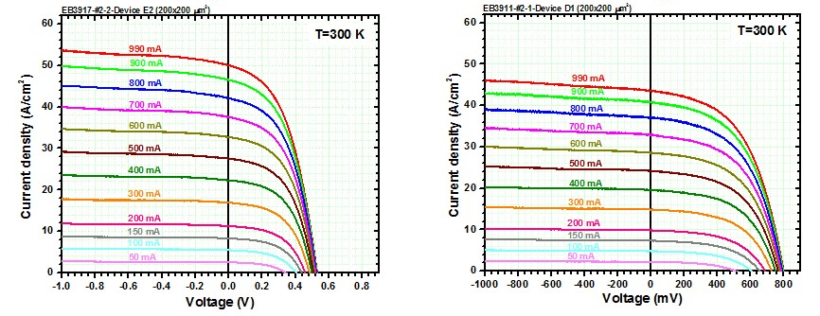
Interband cascade thermophotovoltaic devices
T (K) | J_{sc} (A/cm²) | I_{ph} (mA) | V_{oc} (mV) | R_{s} (Ω) | R_{sh} (kΩ) | FF (%)
300 | 50.0 | 21.0 | 509 | 9.27 | 5.04 | 47.5
340 | 53.6 | 23.5 | 445 | 8.67 | 0.85 | 40.7
T (K) | J_{sc} (A/cm²) | I_{ph} (mA) | V_{oc} (mV) | R_{s} (Ω) | R_{sh} (Ω) | FF (%)
300 | 43.5 | 17.9 | 799 | 12.14 | 9.04 | 51.4
340 | 48.4 | 20.8 | 666 | 11.09 | 1.38 | 44.9

Slide 44
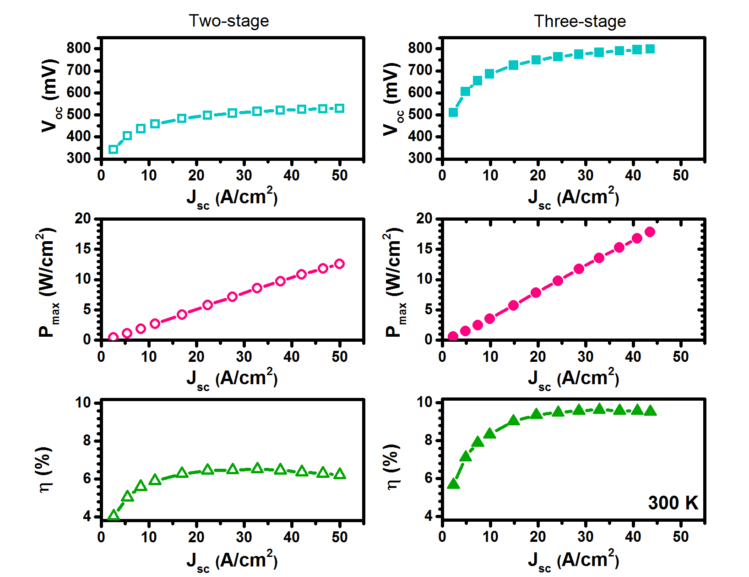
Interband cascade thermophotovoltaic devices
Conversion efficiency:
Two-stage: 6.5 % Three-stage: 9.6 %
The device efficiency exhibited a roll off at high illumination levels

Slide 45
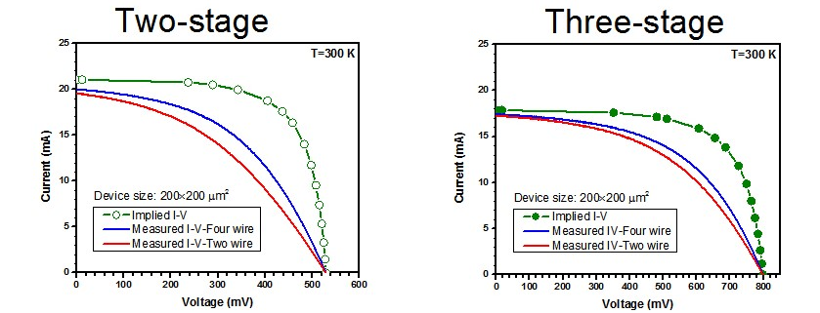
Interband cascade thermophotovoltaic devices
An effective characterization method (based on Suns-V_{oc} technique) for extracting series and shunt resistances was developed
Series resistance was larger in three-stage devices
Larger bulk series resistance due to extra absorber
Non-ideal Ohmic contacts
Unwanted electrostatic barrier in carrier transport path

Slide 46
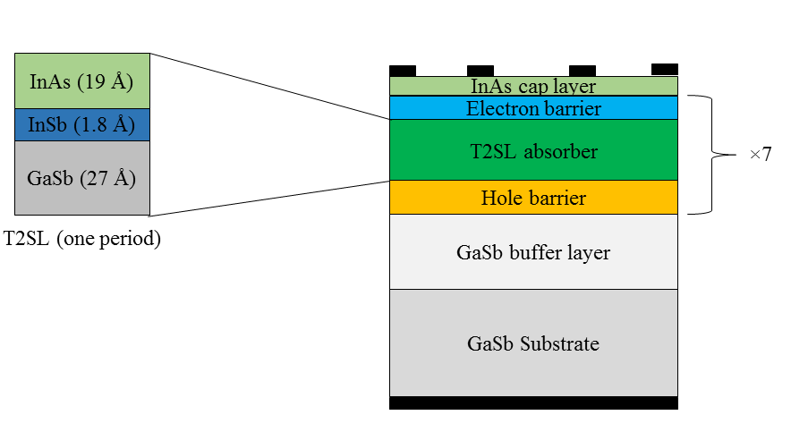
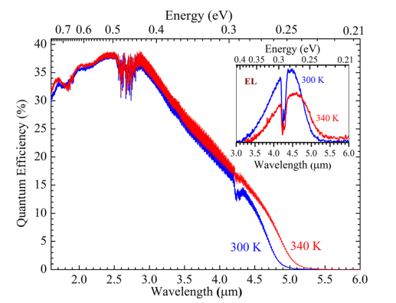
Interband cascade thermophotovoltaic devices
Narrow-bandgap ICTPV devices with seven identical stages
The cutoff wavelength: 5 μm at 300 K and 5.2 μm at 340 K
Relatively low QE:
~31% reflection loss from the air/semiconductor interface
Short overall absorber thickness (~1.1 μm total from seven stages)

Slide 47
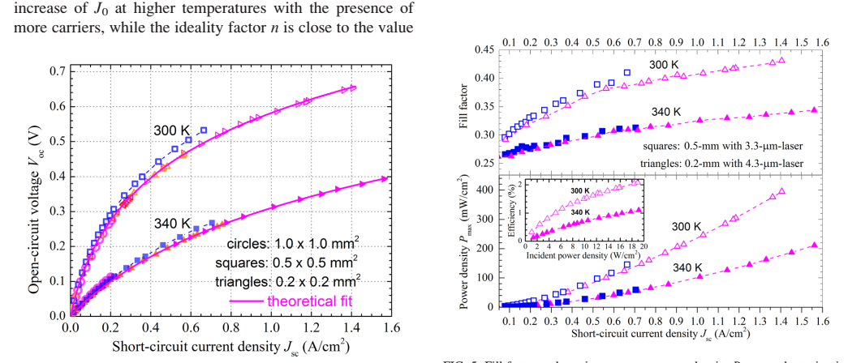
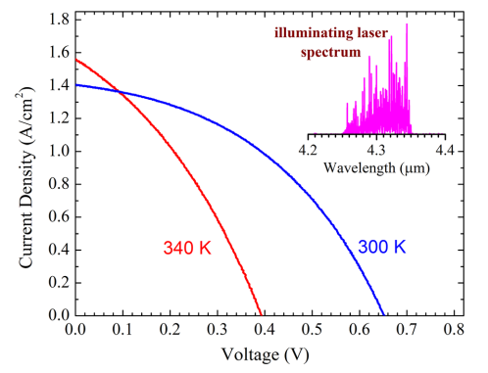
Interband cascade thermophotovoltaic devices
Device performance metrics at 300 K
The highest FF: 43% with illumination of a laser near 4.3 μm
P_{max}: 395 mW/cm² at an incident laser power density of 18.9 W/cm²
Power conversion efficiency: 2.1%

Slide 48
Outline
Background and Motivations
Interband cascade devices: principles of operation
HOT long- and very long-wavelength ICIPs
High-performance short wavelength ICIPs
High-frequency interband cascade systems
Monolithically integrated mid-IR laser and detector
Interband cascade thermophotovoltaic devices
Summary and research perspective

Slide 49
Summary and research perspective
ICIPs are unique structures for HOT and high-speed applications
First demonstration of HOT LWIR and VLWIR ICIPs was discussed
Short-wave ICIPs with three stages had better performance,
there is room for further improvements
Diffusion length seems to be significantly shorter than
a typical absorber in conventional IR detectors
An uncooled high-speed (f_{3dB}≈850 MHz) IC system is demonstrated
Monolithically integrated laser and detector units open new horizons
for on chip spectrometers, lab-on-a chip devices and on-chip
communication
ICTPVs with efficiencies of ~10 % were demonstrated

Slide 50
Acknowledgements
Prof. Rui Q. Yang (advisor)
Prof. Matthew B. Johnson
Prof. Michael B. Santos
Dr. Robert T. Hinkey
Dr. Lu Li
Dr. Hao Ye
S. M. Shazzad Rassel
Lin Lei
Dr. Yuchao Jiang
Dr. John F. Klem of Sandia National Laboratories
Dr. James A. Gupta of National Research Council of Canada
Drs. Yueming Qiu, Dmitri Lubyshev, Joel M. Fastenau, and Amy W. K. Liu of IQE Inc.
Dr. Preston R. Larson
Cédric J. Corrége
Dr. Joel C. Keay
Dr. Tetsuya D. Mishima
Profs. Zhisheng Shi, J. R. Cruz and Ian R. Sellers
Wenxiang Huang
Lihua Zhao
And my wife, friends and family
The research presented in this dissertation was supported by funding from DoE EPSCoR program
(Award No. DE-SC0004523), C-SPIN, the Oklahoma/Arkansas MRSEC (Award No. DMR- 0520550),
AFOSR (Award No. FA9550-12-1-0260), NSF (Award No. ECCS-1202318),
AFOSR (Award No. FA9550-15-1- 0067), NSF (Award No. DMR-1229678),
and NSF (Award No. DMR-1608224).

Slide 51
Thank You!

Slide 52
Backup

Slide 53


Long-wavelength ICIPs
Two-stage ICIPs with cutoff wavelength of ~ 9.2 μm (78 K)
Absorber 1: 620 nm
Absorber 2: 756.4 nm
Stage 1
Stage 2

Slide 54


Long-wavelength ICIPs
Bias dependent response at high temperatures (167 K and above):
Decreased diffusion length
Switching of the residual doping from p-type to n-type
D*: 3.7×10¹⁰ cm.Hz^{1/2}/W at 78 ◦K
Best D* for ICIPs of similar wavelength: 1.3×10¹¹ cm.Hz^{1/2}/W
See J. Appl. Phys. 120, 193102 (2016).

Slide 55




Suns-V_{oc} technique
$$I_{ph}=I_{o}\left(exp\left[{qV_{oc}}/{nk_{B}T}\right]−1\right)+\frac{V_{oc}}{R_{sh}}$$
$${ I}_{t}=I_{sc}\left(1−P_{n}\right)$$
$$I_{t}=I_{ph,max}\left(1−\frac{I_{ph}}{I_{ph, max}}\right)$$

Slide 56






Some math on ICIPs
$I_{ph}=q\int_{0}^{t}{g_{ph}(x)f_{c}(x)dx}$
$D^{∗}=\frac{λ}{hc}\frac{EQE}{\sqrt{4g_{th}L_{e}}}\sqrt{\sum_{m}{\frac{1}{tanh⁡\left(\frac{t_{m}}{L_{e}}\right)}}}$
$f_{c}\left(x\right)=\frac{cosh⁡({(t−x)}/{L_{e}})}{cosh⁡(t/{L_{e}})}$
$$g_{ph}\left(x\right)=α\left(λ\right)φ_{0}e^{−α(λ)x}$$
$R_{0}A=\frac{k_{B}T}{q^{2}g_{th}L_{e}}\sum_{m}{\frac{1}{tanh\left(\frac{t_{m}}{L_{e}}\right)}}$
$$EQE=\left[\frac{αL_{e}}{1−{\left(αL_{e}\right)}^{2}}\right]\left[\frac{Sinh\left({t_{1}}/{L_{e}}\right)+αL_{e}e^{−αt_{1}}}{cosh\left({t_{1}}/{L_{e}}\right)}−αL_{e}\right]$$

Slide 57


Absorption and diffusion length

